Slide 1



Spatiotemporal patterns and correlates of psoriasis: an epidemiological analysis at the global level
Supervisor: Maugeri Andrea Giuseppe
Co-supervisor: Prof. Giuliana Favara
By: Bisht Ashish Singh

Slide 2



Table of contents
INTRODUCTION
DATA PREPARATION
EDA
COORELATION
PCA
CLUSTERING
MODELLING
SPATIOTEMPORAL ANALYSIS
CONCLUSION

Slide 3
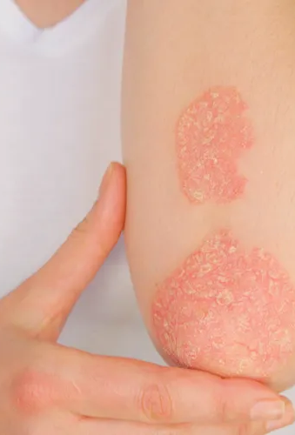
What is PSoriasis ?
Psoriasis is a chronic inflammatory skin condition that significantly affects the quality of life of people and poses substantial challenges to healthcare systems around the world.
According to WHO (World Health Organization), 2-3 percent of the global population is affected by this skin condition, which is approximately 125 million people worldwide and adds significantly to global DALYs and YLDs, yet remains underdiagnosed and underprioritized in many countries.
Psoriasis causes long term physical and psychological burden, contributing to disability, depression, and reduced quality of life.

Slide 4
Dataset Preparation
Integrated two datasets (1990–2021):
• Psoriasis burden data from IHME-GBD
• Development indicators from the World Bank
GBD data included 4 metrics:
• DALYs, YLDs, Prevalence, Incidence for 200 countries
World Bank data initially had 389 indicators (socioeconomic, environmental, demographic)
Preprocessing steps:
• Temporal alignment (1990–2021)
• Zero-value handling (placeholder correction)
• Column renaming & country name harmonization
• Merged by country and year (inner join)
• Removed indicators with >25% missing values
• Selected 74 indicators via correlation; retained 67 for analysis

Slide 5


Exploratory Data analysis

Slide 6
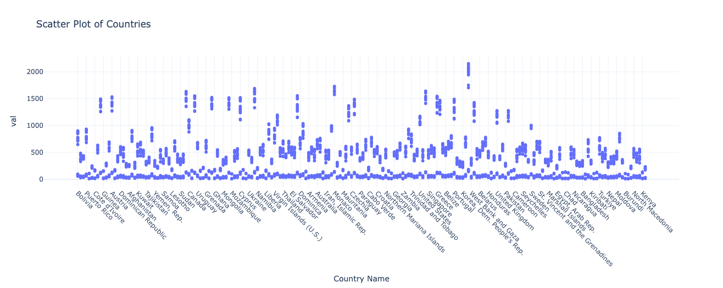
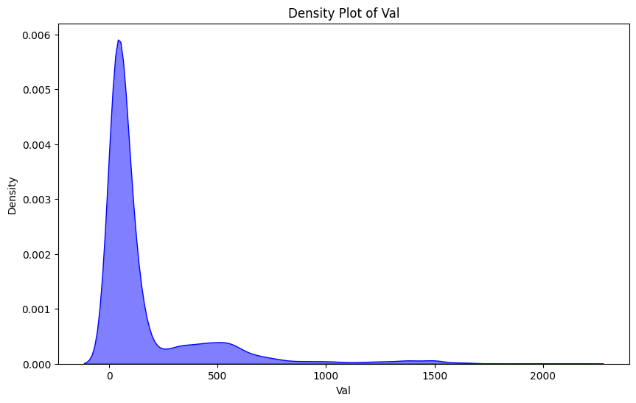
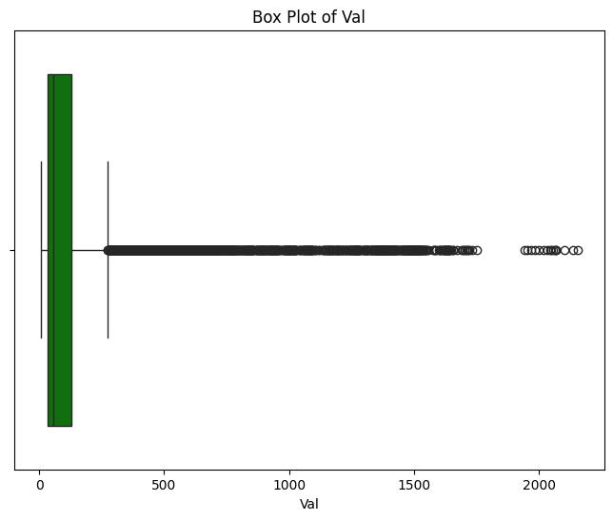
Distribution of val
“val” represents psoriasis burden metrics across all countries and years
Wide variation across countries, some report very high values (>2000), others much lower
Highly right-skewed distribution with most values clustered near the lower end
Boxplot shows significant outliers, suggesting regional or reporting differences

Slide 7
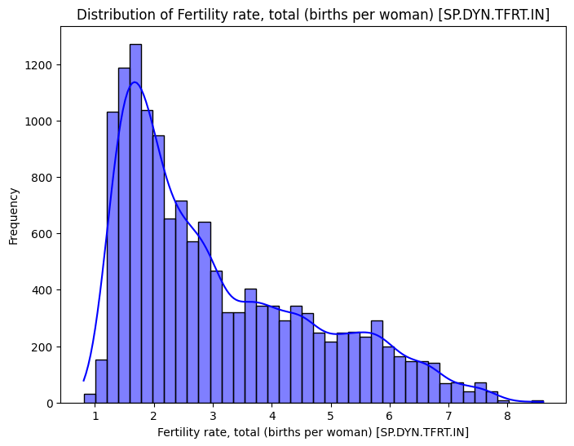
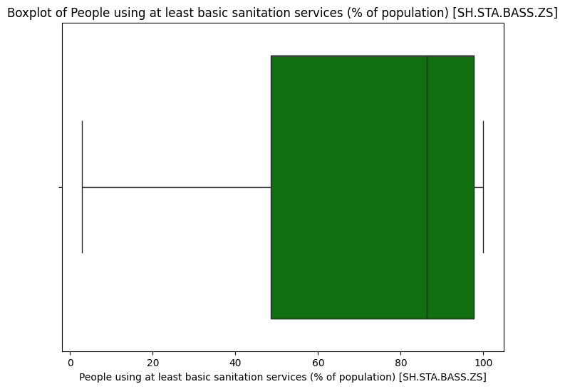
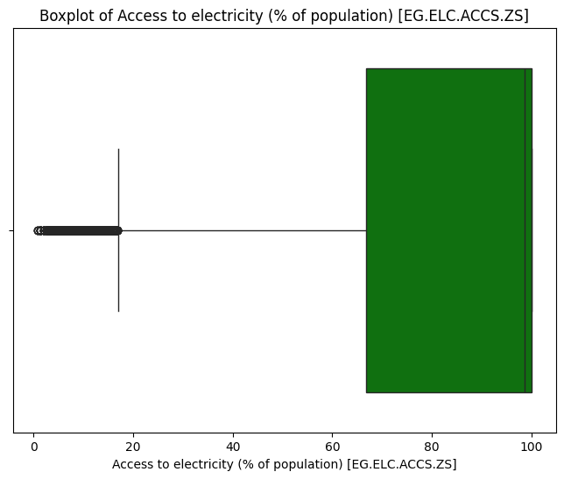
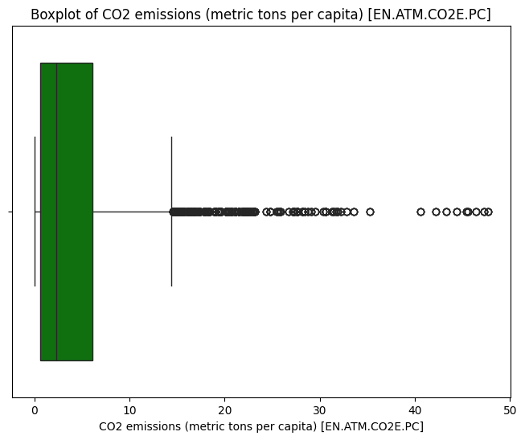
UNIVARIATE ANALYSIS
Sanitation and electricity access show high median values but large gaps in low-income regions
CO₂ emissions per capita have extreme outliers — a few countries emit over 30 tons per capita
These patterns highlight development disparities and justify variable scaling for modelling
Fertility rate shows a right-skewed distribution, with most countries between 1–4 births per woman

Slide 8
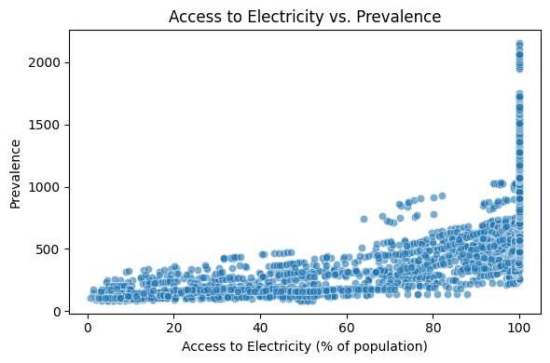
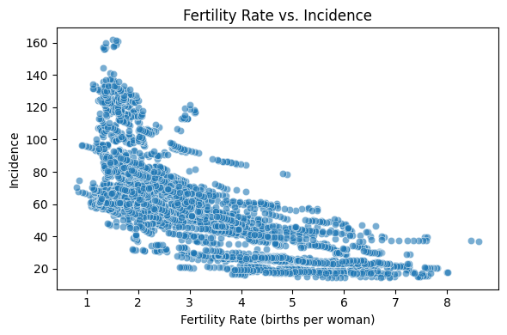
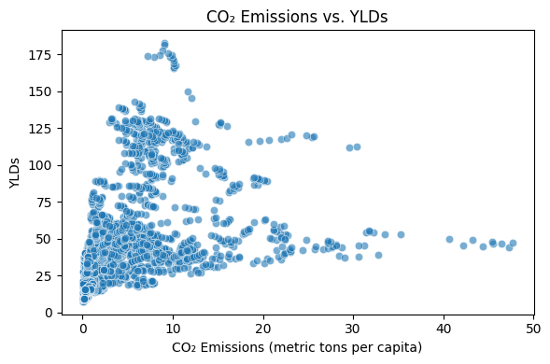
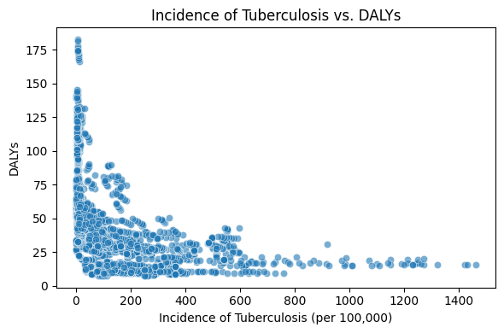
Bivariate Relationships
Access to Electricity vs. Prevalence
A positive relationship is observed: countries with higher access to electricity tend to report higher prevalence of psoriasis, possibly reflecting better diagnosis/reporting in more developed regions.
Fertility Rate vs. Incidence
A strong inverse relationship emerges: higher fertility rates correlate with lower incidence of psoriasis, potentially linked to age demographics and healthcare infrastructure.
Tuberculosis Incidence vs. DALYs
An inverse pattern is seen: high tuberculosis rates are associated with lower psoriasis DALYs, suggesting competing health burdens in low-income regions.
CO₂ Emissions vs. YLDs
The relationship is non-linear and scattered: though no clear pattern, this contrast highlights the complexity and contextual nature of environmental factors.

Slide 9
Time-Series Imputation for Missing Data
To preserve the temporal integrity of the dataset and ensure continuity in country year observations, a time-aware imputation strategy was applied:
LOCF (Last Observation Carried Forward)
NOCB (Next Observation Carried Backward)
Fills missing values using the most recent past observation.
If past data is missing, the next available future observation is used.
The combined LOCF + NOCB approach ensured complete data coverage across 1990–2021 while minimizing the risk of artificial trend creation.
This imputation was crucial for reliable performance in downstream analyses such as Correlation, PCA and regression

Slide 10
Correlation analysis

Slide 11
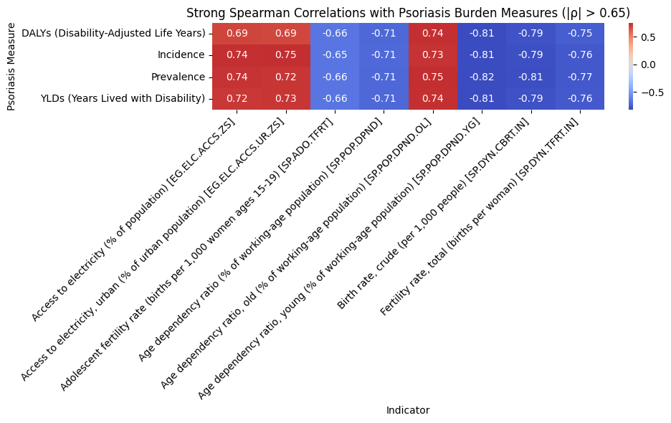
Correlation Analysis of the Indicators
Objective:
Identify indicators most strongly associated with psoriasis burden measures (Prevalence, Incidence, DALYs, YLDs).
Method:
Spearman rank correlation (|ρ| > 0.65)
Focused on numeric variables only
Correlation calculated per measure
Key Findings:
Access to electricity and basic services show strong positive correlations across all burden metrics.
Age dependency ratio (young) and fertility indicators have strong negative correlations.
Indicators related to infrastructure and demographics are consistently relevant.

Slide 12
Principal component analysis (pca)

Slide 13
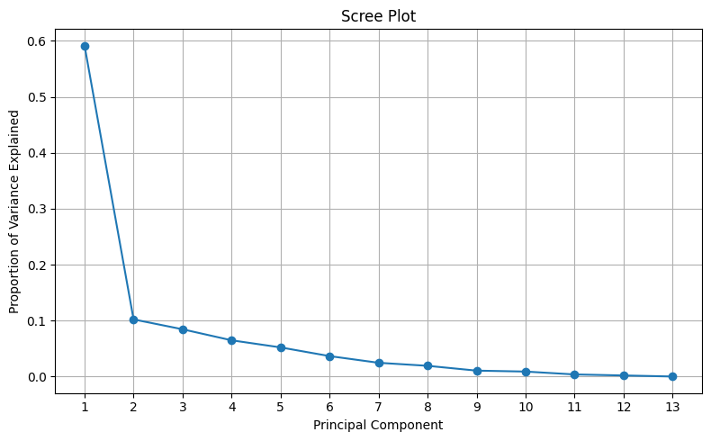
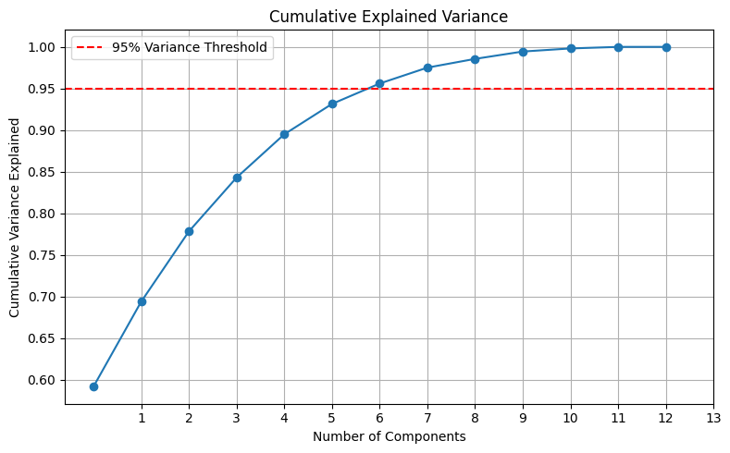
To address multicollinearity and reduce the dimensionality of the dataset, Principal Component Analysis (PCA) was performed on a subset of indicators that showed strong correlations (|r| or |ρ| > 0.65) with psoriasis burden metrics (Prevalence, Incidence, YLDs, and DALYs). PCA transforms correlated variables into orthogonal principal components (PCs), capturing the most variation in the data with fewer dimensions.

Slide 14
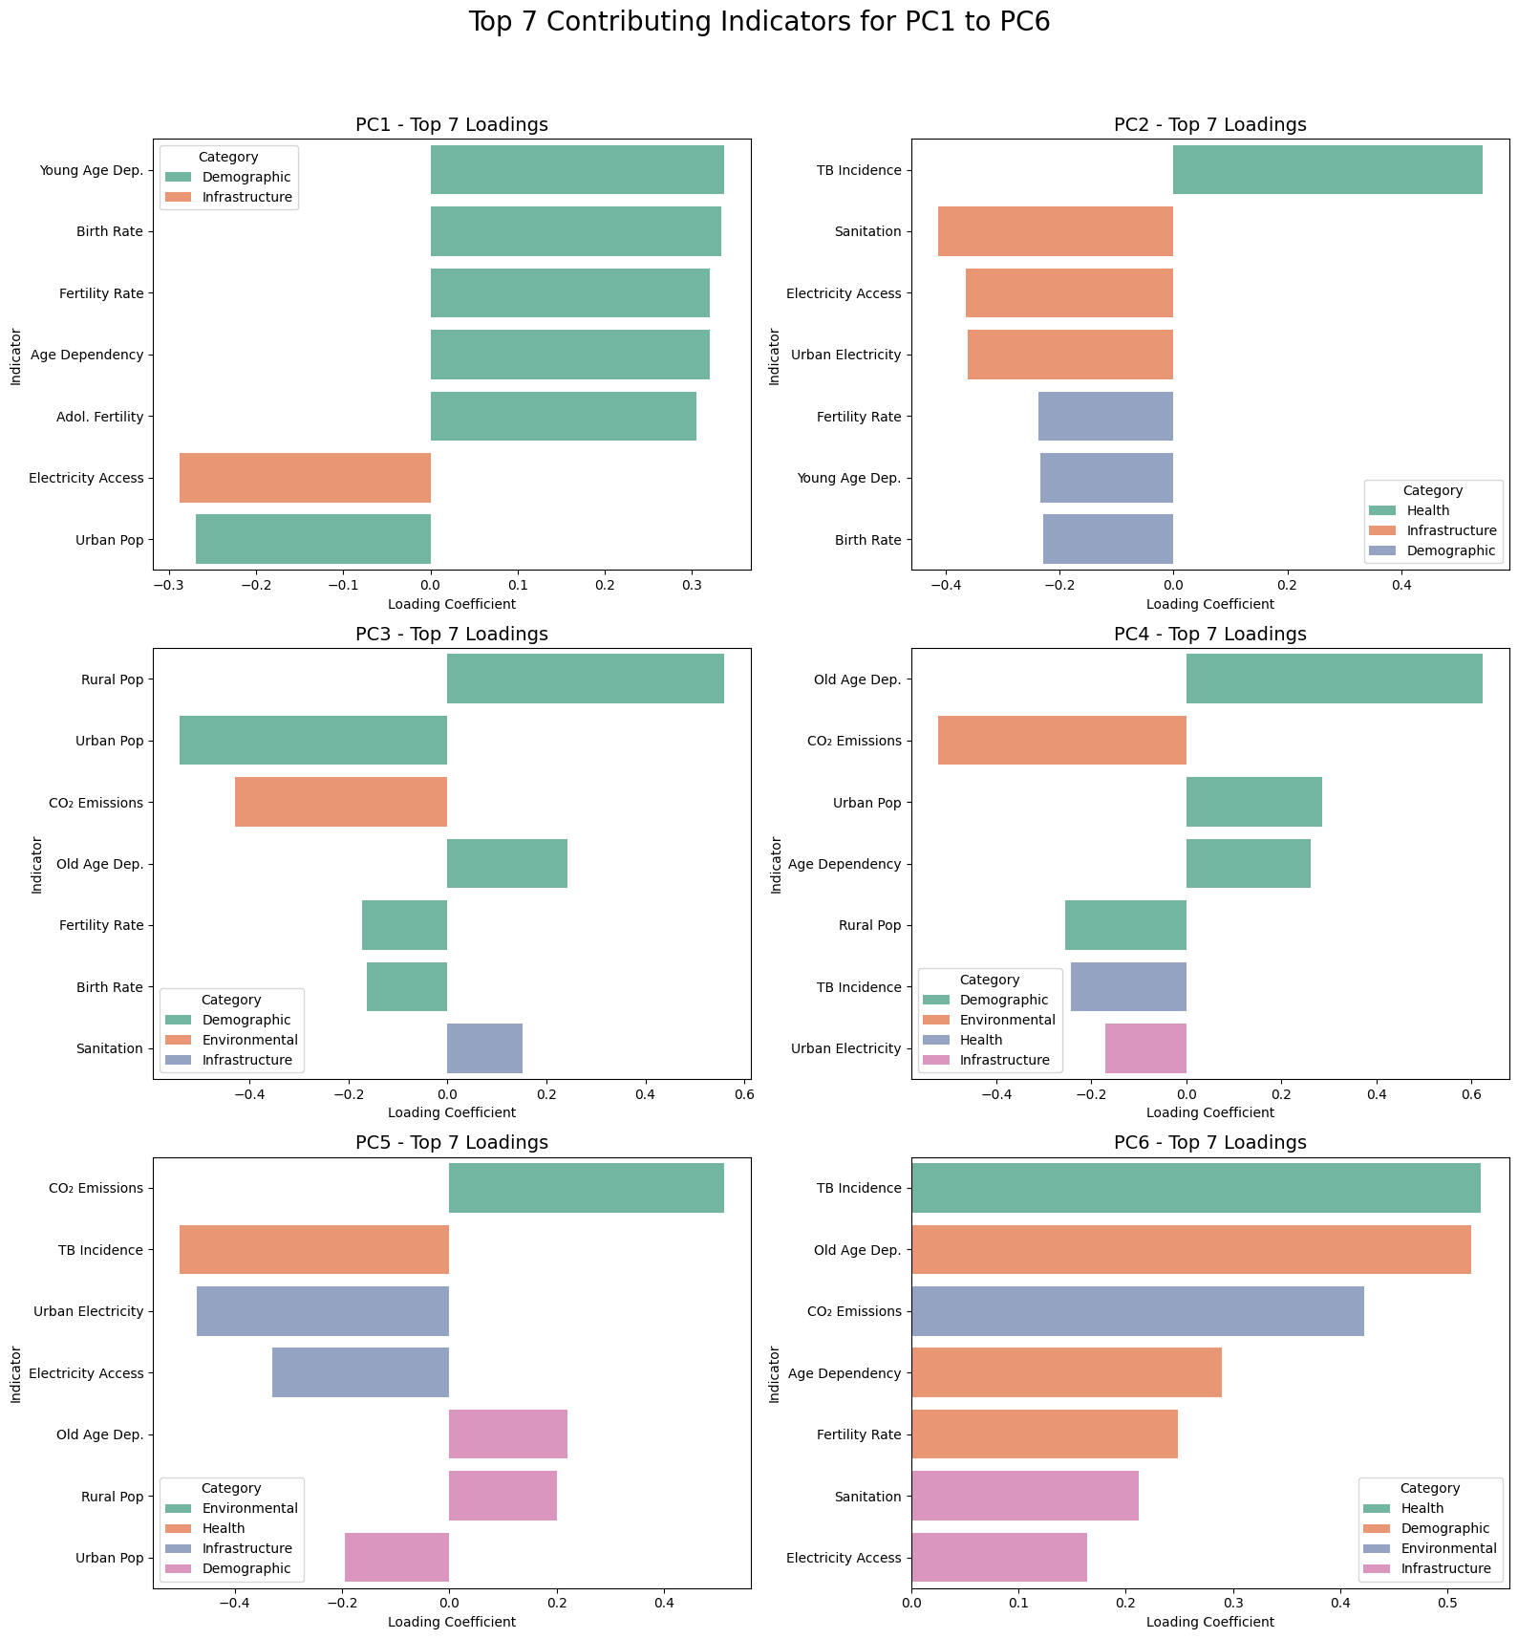
Principal component Interpretation
PC1: Captures high fertility and youth dependency, opposing urbanization and electricity access — reflects population growth in rural settings.
PC2: Reflects basic infrastructure and disease burden, contrasting sanitation/electricity with TB incidence.
PC3: Represents urbanization vs. rural–low emission contexts, shaped by CO₂ emissions and population distribution.
PC4: Highlights ageing, urbanization, and pollution, dominated by old-age dependency and CO₂.
PC5: Focuses on infrastructure gaps, with inverse loadings from emissions and TB vs. sanitation and electricity.
PC6: Indicates compound vulnerabilities — ageing, pollution, and poor health outcomes.

Slide 15
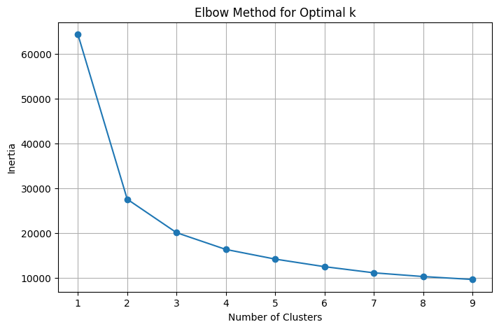
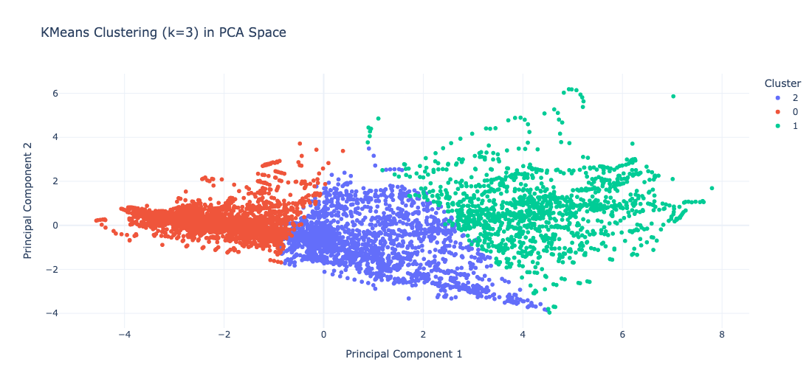
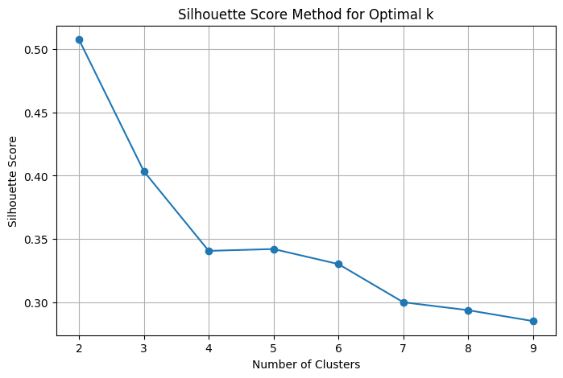
Clustering Countries Based on Principal Components
Elbow method indicates optimal clusters at k=3
While k=2 gives the best score, k=3 gives slightly lower score but justifies the interpretability of the clusters.
Kmeans clustering results visualized in PCA space

Slide 16
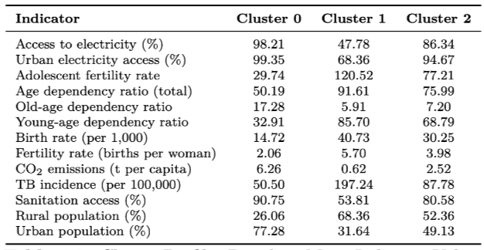
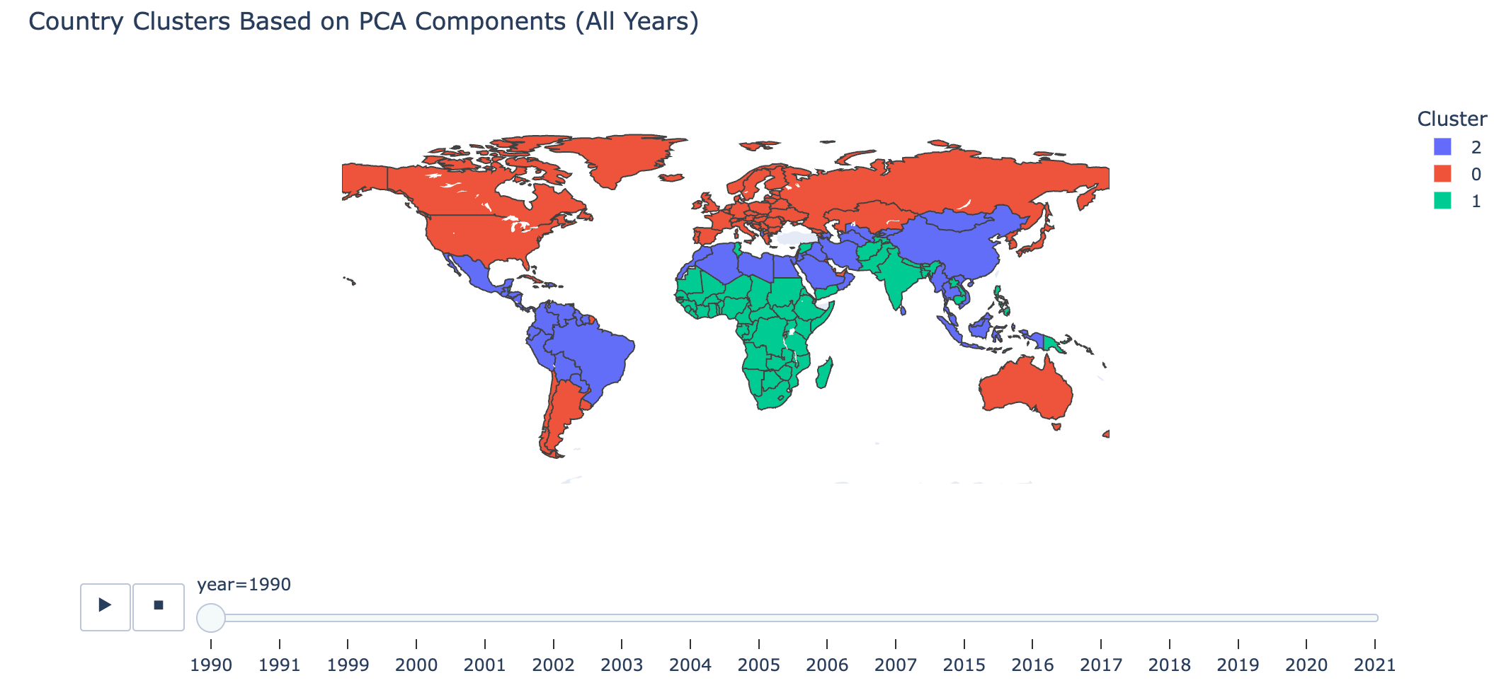
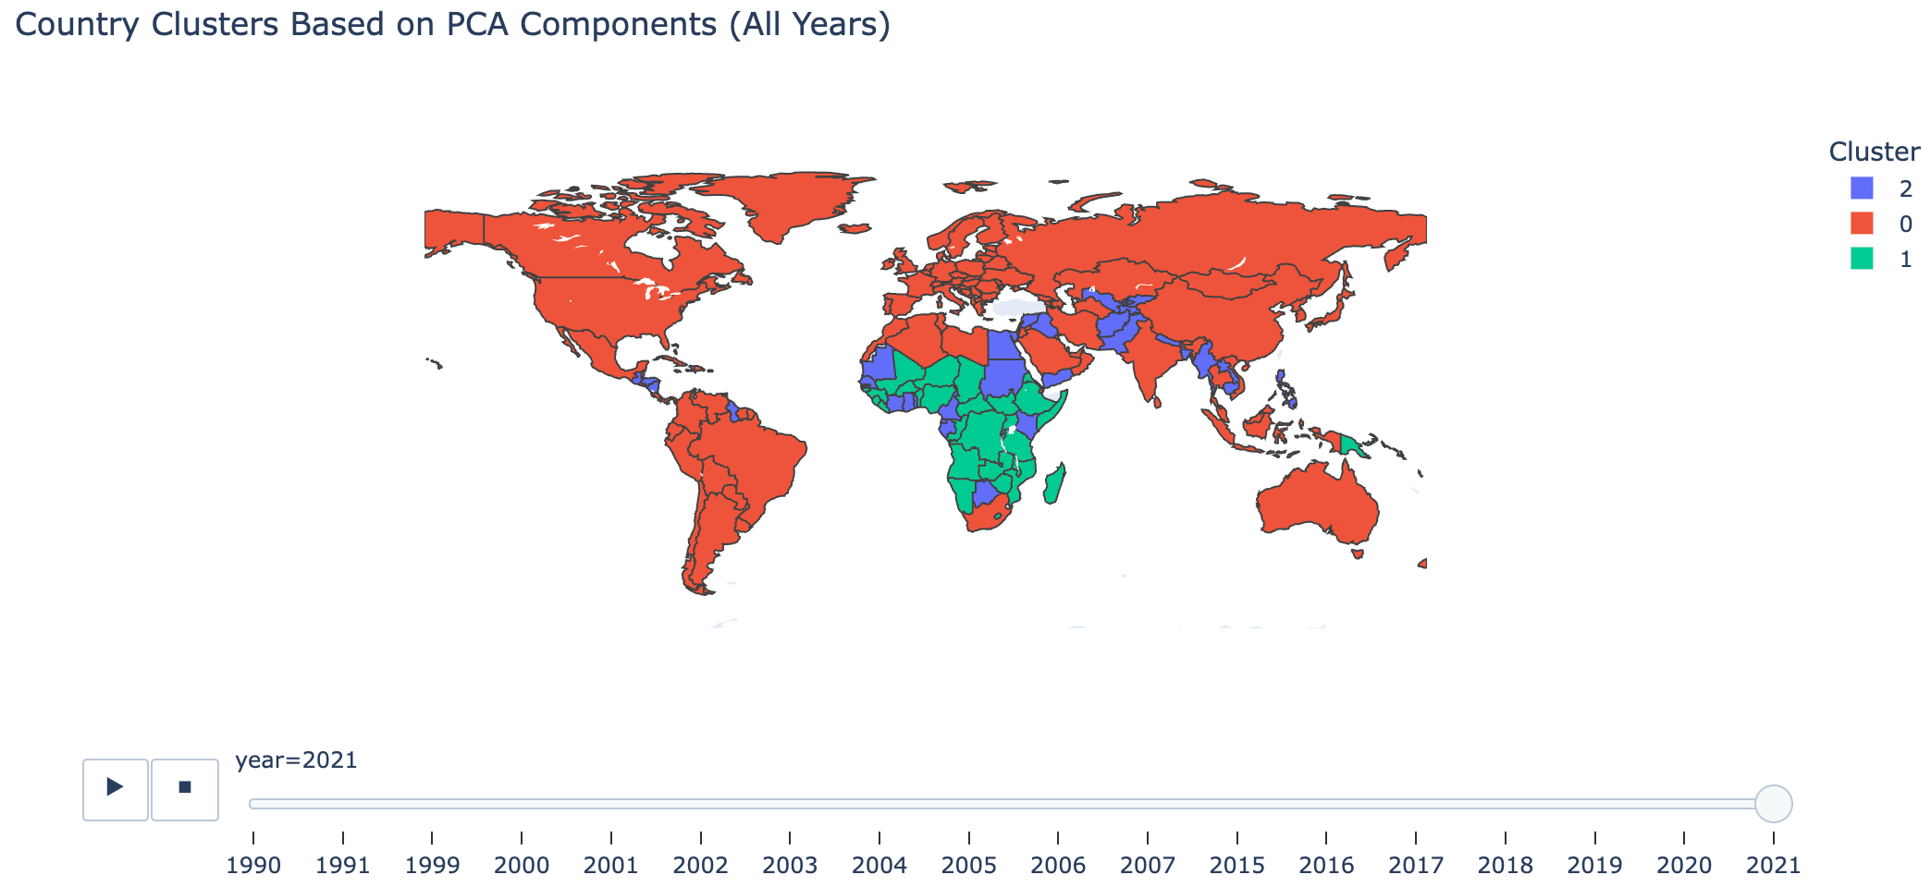
Cluster Profiles: Socio-Demographic and Health Characteristics
1990 Cluster Distribution
Table summarizes mean values of key socio-demographic and health indicators across the three clusters. Cluster 0 shows high development, Cluster 1 low development, and Cluster 2 intermediate characteristics
2021 Cluster Distribution

Slide 17
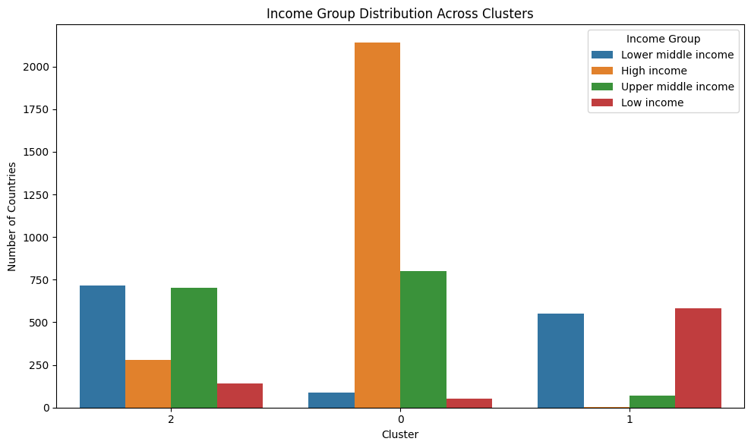
Income Group Distribution Across Clusters
This bar plot illustrates the income group distribution within each cluster.
We can clearly see that:
Cluster 0 mainly includes high- and upper-middle-income countries.
Cluster 1 is dominated by low-income countries.
Cluster 2 is a blend — heavily composed of lower-middle and upper-middle-income nations.
This confirms that our clustering meaningfully reflects global development patterns.”

Slide 18
MODELLING

Slide 19
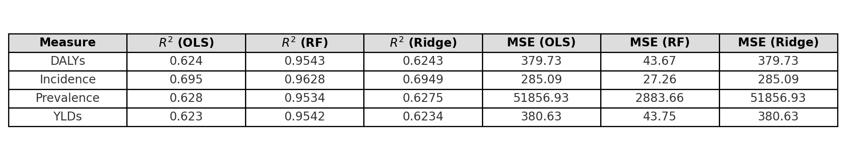
Modelling Psoriasis Burden
Objective
To identify key development indicators that predict global variations in psoriasis burden (Prevalence, Incidence, DALYs, YLDs).
Methods Used:
OLS Regression: For baseline linear associations.
Ridge Regression: Handles multicollinearity and regularizes coefficients.
Random Forest Regression: Captures non-linear relationships and variable interactions.
Model Evaluation: Random Forest consistently outperformed others, showing better fit and robustness.

Slide 20
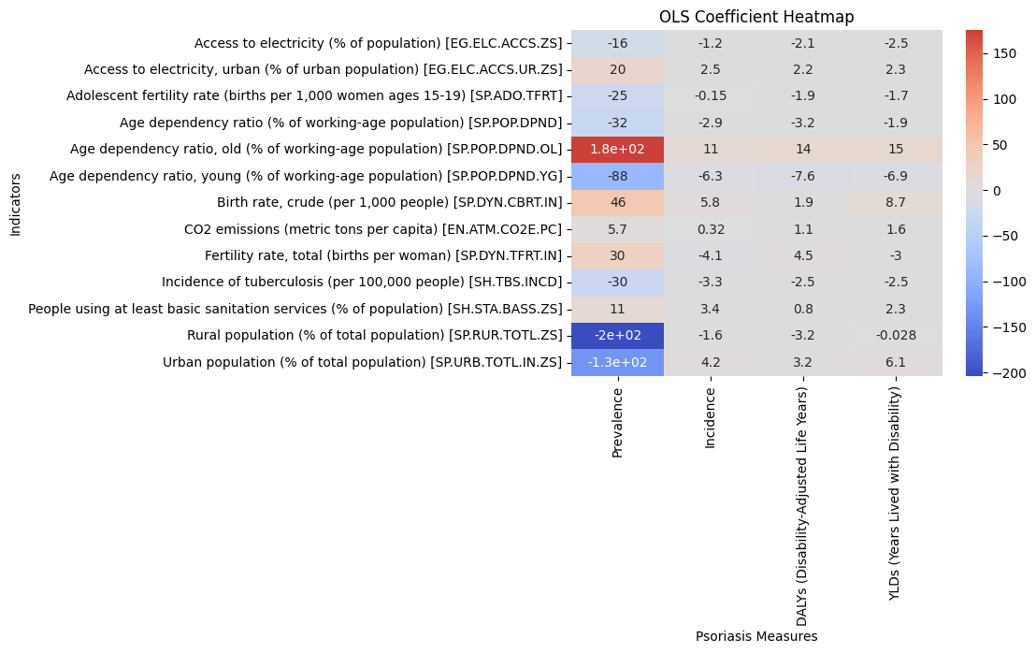
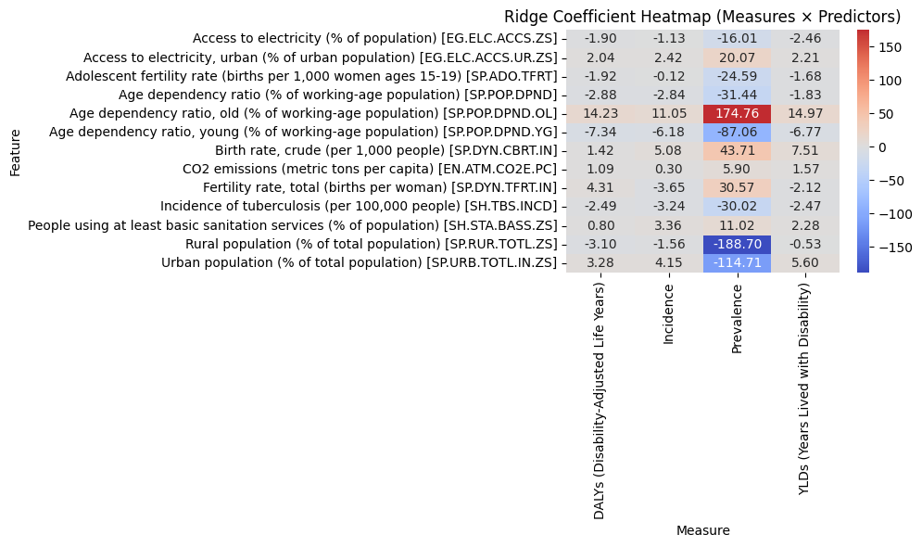
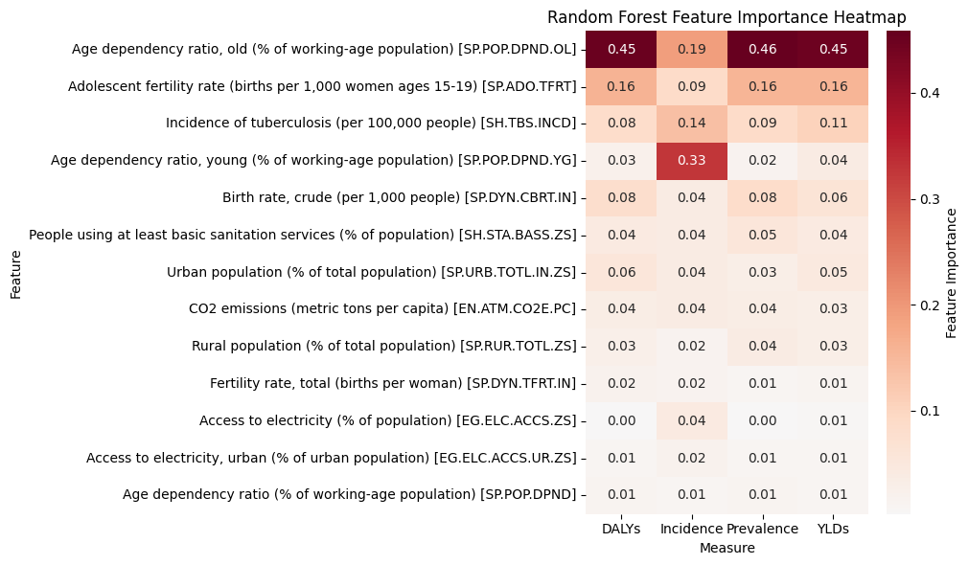
Key Predictors & Interpretation
Significant Predictors (common across models):
Sanitation Access (+ve association with DALYs, Incidence)
Urban Population % (+ve for Prevalence, DALYs)
CO₂ Emissions (sometimes +ve, showing links to industrialization)
TB Incidence (−ve or weakly associated in some models)
Insights:
Higher psoriasis burden is often found in more urbanized, industrialized settings.
Some predictors suggest healthcare access/reporting bias in higher-income nations.
Random Forest revealed non-linear effects missed by
linear models.

Slide 21
Spatiotemporal analysis

Slide 22
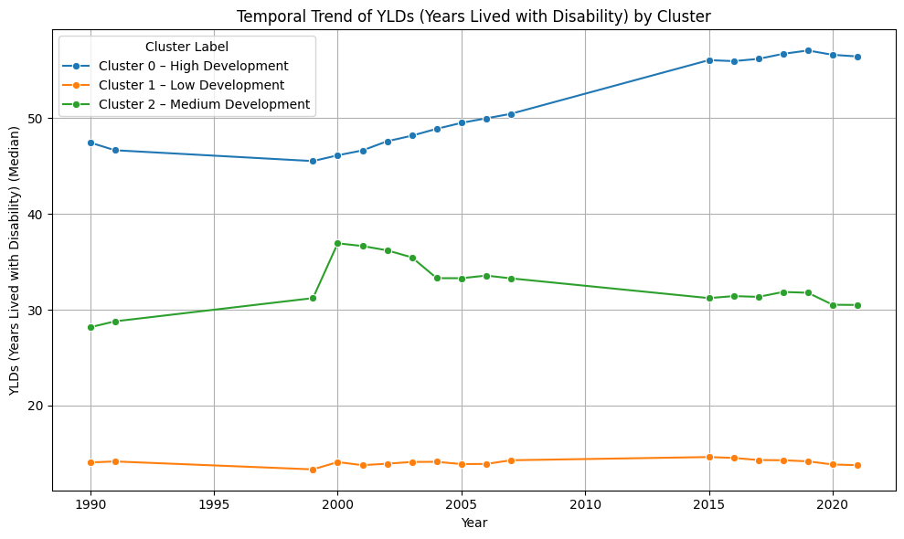
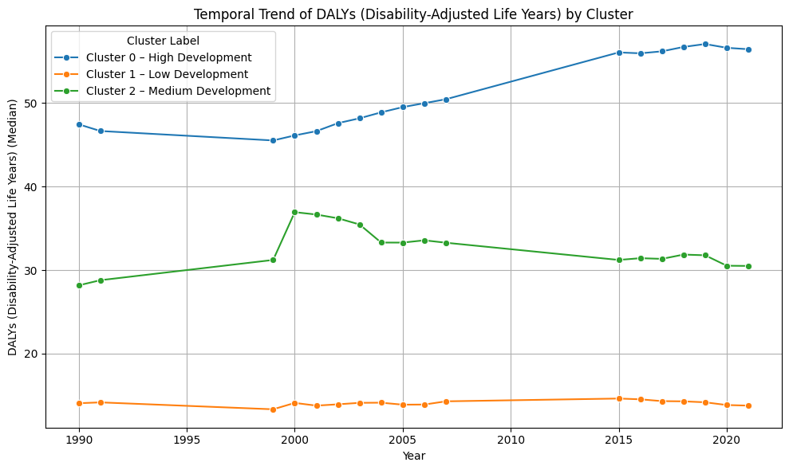
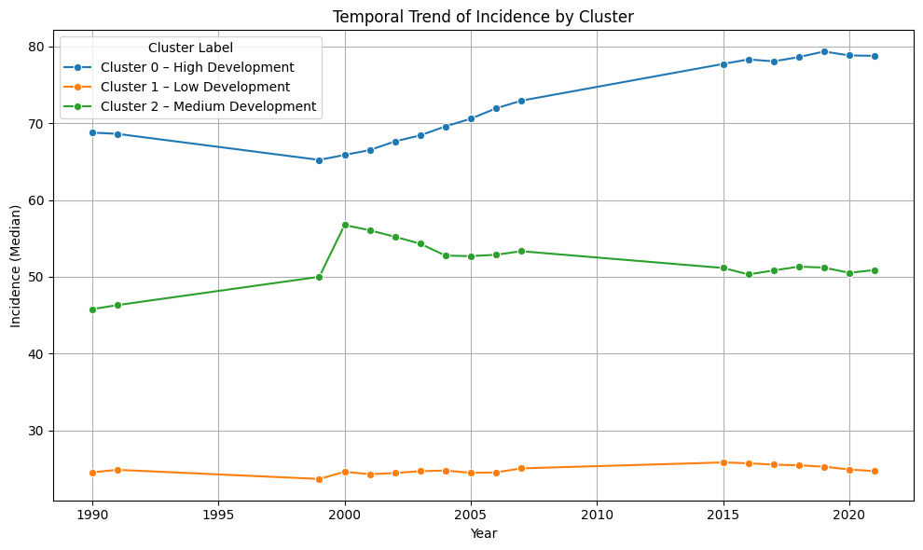
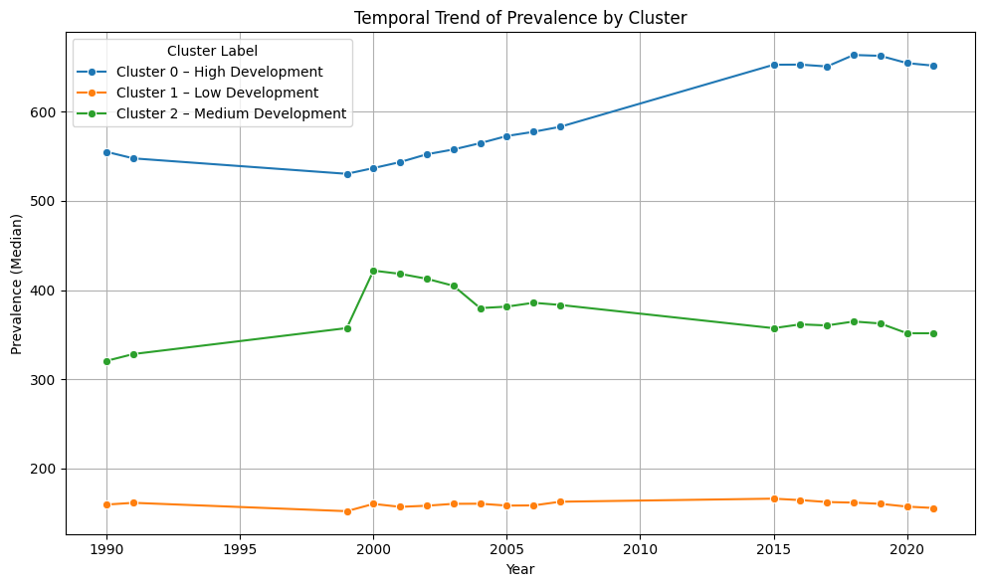
Temporal Trends of Psoriasis Burden (1990–2021)

Slide 23
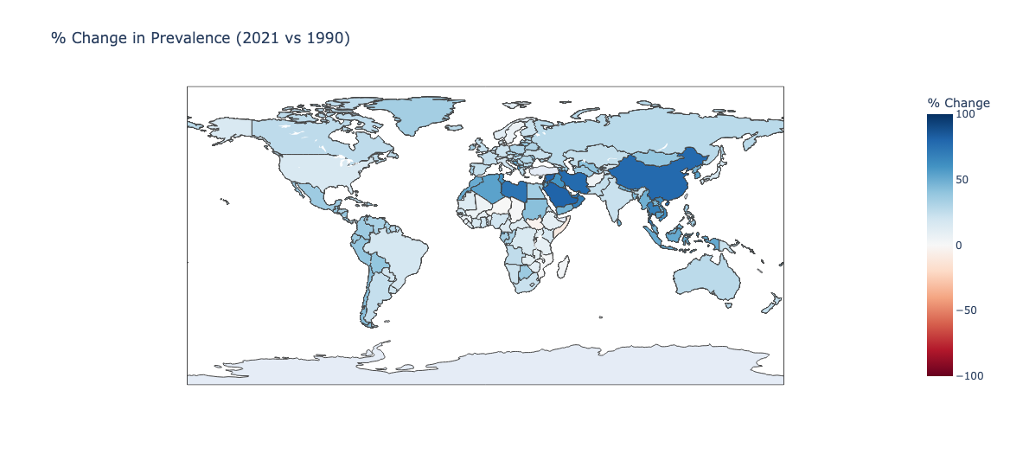
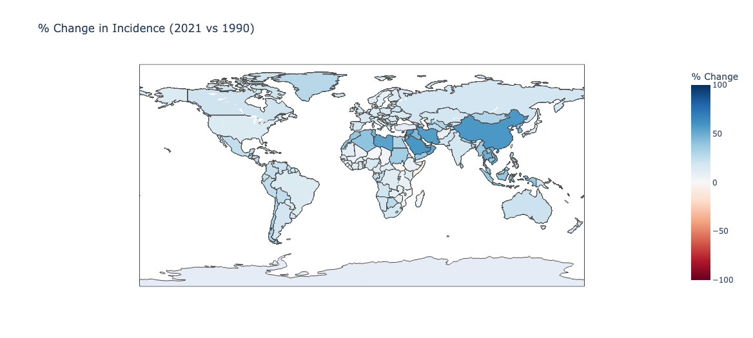
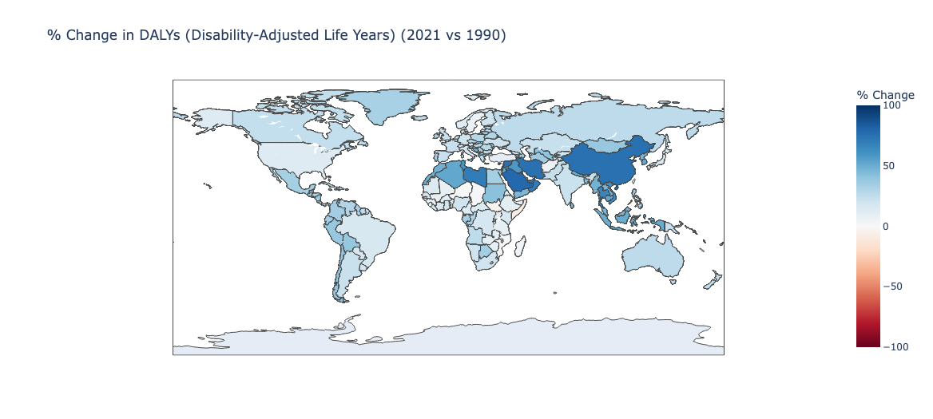

Global % Change in Psoriasis Burden (1990–2021)

Slide 24
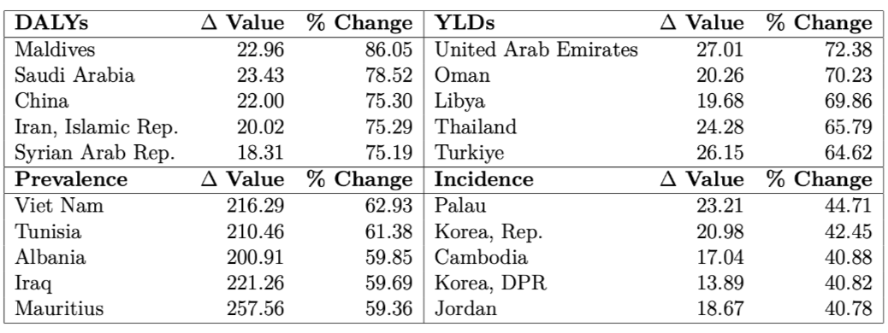
Top Countries by Increase in Psoriasis Burden (1990–2021)
This table highlights the countries with the highest absolute and percentage increases in psoriasis burden over the 31-year period, based on Δ value and % change for each indicator:
DALYs: The Maldives and Saudi Arabia show the sharpest rise in disease burden, with Maldives recording an 86% increase, indicating worsening health outcomes or better detection.
YLDs: The UAE, Oman, and Libya show notable increases in disability burden, reflecting the growing chronic impact of psoriasis in these regions.
Prevalence: Countries like Mauritius, Viet Nam, and Iraq have seen large increases in the number of people living with psoriasis, with over 59% growth, suggesting rising awareness or true epidemiological expansion.
Incidence: While the increases are more modest, Palau, South Korea, and Cambodia lead the rise in new psoriasis cases, potentially tied to improved diagnostics or lifestyle shifts.

Slide 25
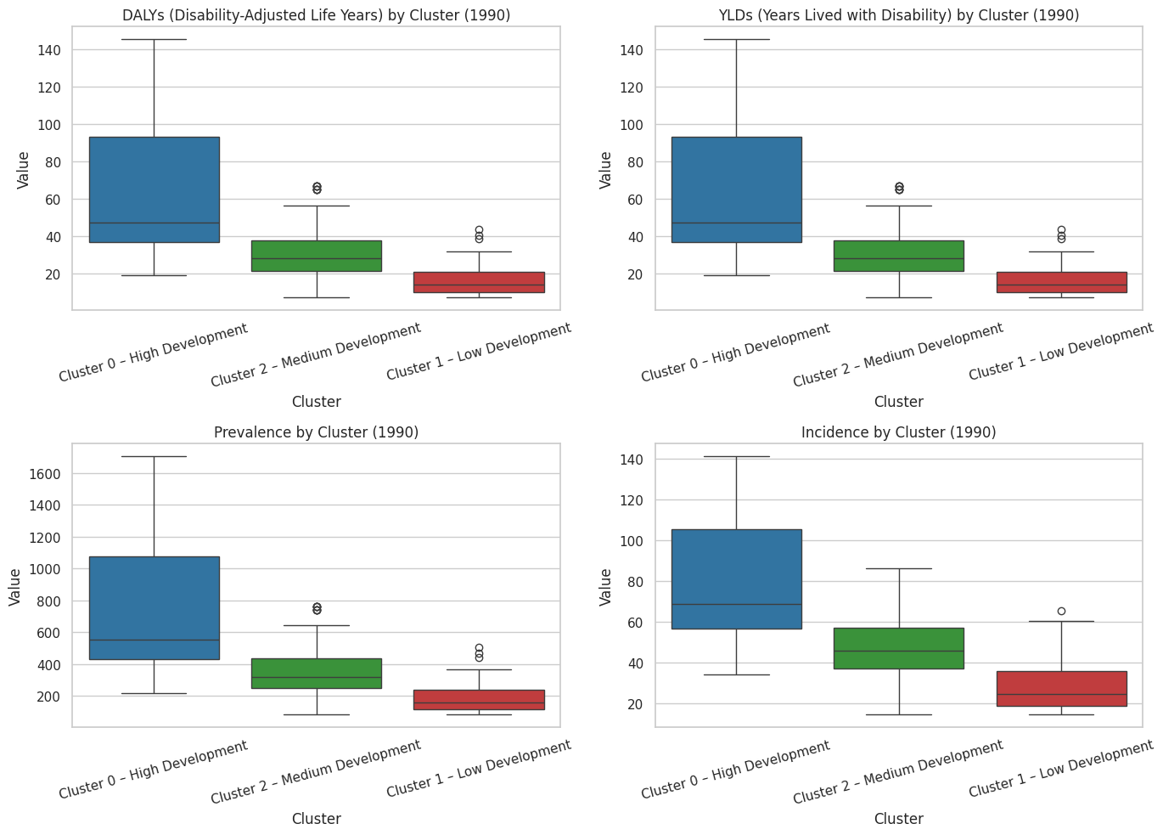
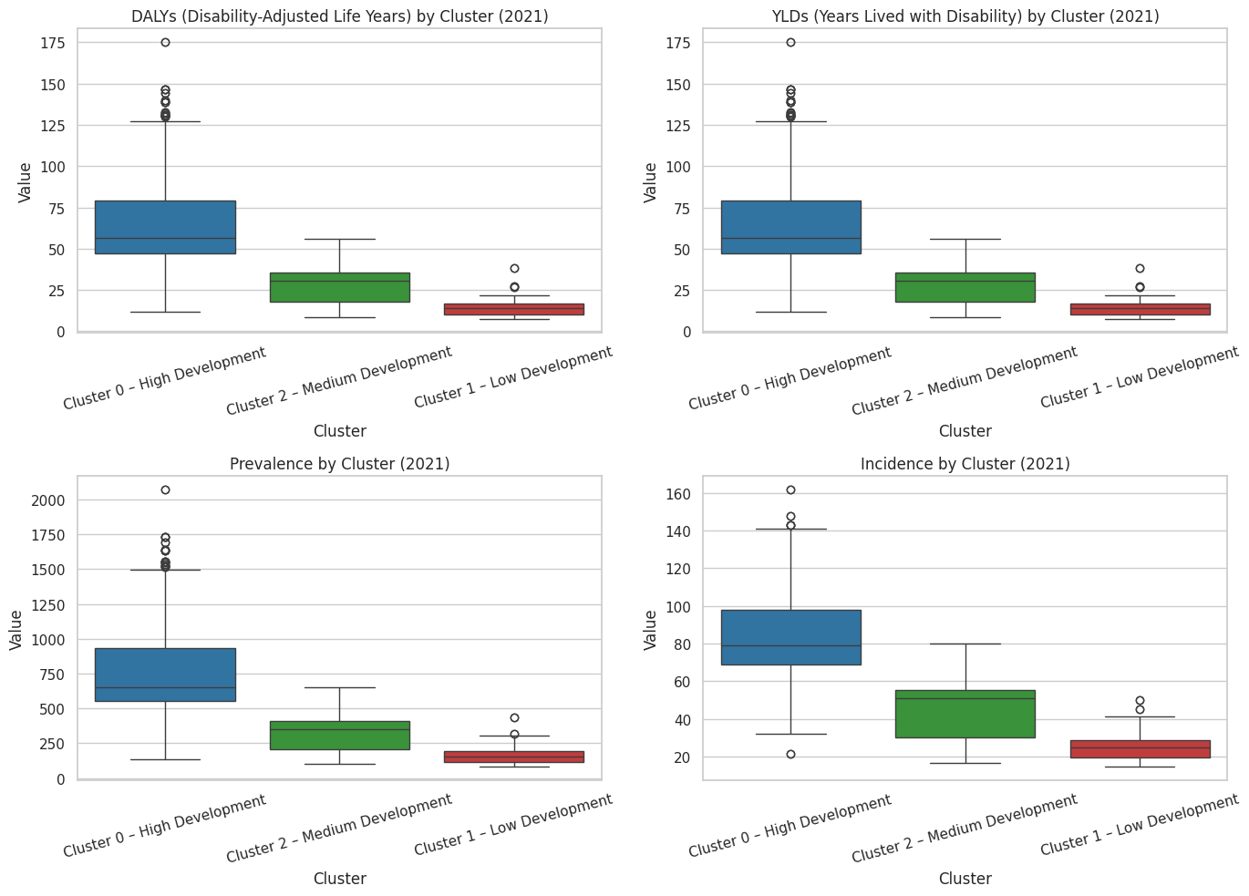
Baseline Burden by Development Cluster (1990)

Slide 26
Conclusion
Psoriasis burden is rising globally, particularly in high-development clusters, with DALYs, YLDs, Prevalence, and Incidence showing an upward trend from 1990 to 2021.
PCA-based clustering revealed distinct burden profiles:
Cluster 0 (High Development): Highest and rising burden, likely due to better diagnosis and aging populations.
Cluster 1 (Low Development): Consistently lower values, possibly due to underdiagnosis and poor reporting.
Cluster 2 (Medium Development): Moderate levels with mixed trends.
Regression models (OLS, Ridge, Random Forest):
Consistently identified age structure (especially elderly population), fertility, and urbanization as key predictors.
Random Forest highlighted non-linear relationships and interactions often missed in linear models.
Spatial maps and country-level changes indicate regions with rapid increase, particularly in the Middle East, South Asia, and parts of Africa.

Slide 27


Thank you for yur attention

